Slide 1
HYBRID RECOMMENDER SYSTEM FOR
TOURISM
BASED ON BIG DATA AND AI: A CONCEPTUAL
FRAMEWORK

Slide 2
ABSTRACT
Now a day mobile phone is a needful part of the people’s life. There is continuously rising in a number of mobile computing applications, concentrate on the people’s daily life. In such applications, location dependent systems have been detected as a significant application. Such application which presents the architecture and implementation of such a location is commonly known as Smart City Guide. The main motive of the project is to explore how to realize a mobile city guide using the Android platform, including a prototype of the city guide. The project uses the research method design science. Through designing and implementing an artifact (that is prototype of city guide), the goal project is reached. Finally, the project is assess in four aspects including platform evaluation, general functional evaluation, scenario evaluation and non-functional evaluation. The prototype implemented include basic functionalities of city guides such as showing the map, locating points of interest (POIs). Beside, the project has inspect how to combine present technologies like Google Map and the phone application into the prototype. The app comforts a new native in a city by showing information of all the nearby sites that can be used for public access. Sites include Hospital Services, Police Station, Main Attraction Of City, Famous Restaurants. As well, the project has investigated non-functional aspects including extendibility, tolerability, and usability. Overall, the project presents a comprehensive unrealized city guide on the new mobile Android platform.

Slide 3
INTRODUCTION
City Guide is an essential whenever we are visiting a particular city. It gives us the valuable information about the city and saves the time. The project title is ‘A COMPLETE CITY GUIDE USING DATABASE’, a web-based platform used to store the details of particular city and helps all the users who have just visits our website and registered in the site, they can search for a prominent places in the city without taking any help from personal guide. The website contains the complete information about particular city like places to be visited, site maps route maps, Business environment, Job portal, information about organization that provide transport, Hospitality and total history of the city. This website can be used by any person who is having general knowledge about internet. All the users will be first considered as anonymous user later if he needs any service then he will be treated as registered user.

Slide 4
OBJECTIVE
The prototype implemented include basic functionalities of city guides such as showing the map, locating points of interest (POIs). Beside, the project has inspect how to combine present technologies like Google Map and the phone application into the prototype. The app comforts a new native in a city by showing information of all the nearby sites that can be used for public access.

Slide 5
SCOPE OF THE PROJECT
It can be accessed by unlimited number of users. Each user will be assigned a different set of permissions for each module of the system. The user can have access to all the information in the site with limited services and provide extra services to registered users. Track all the transaction details of the customer. Confirmation of end user identity and will verify which users are authorized to receive Support. Maintain history of each customer and their related Maintain history of each customer and their related information.

Slide 6
S.NO | TITLE | AUTHOR/YEAR | WORKDONE | KNOWLEDGE GAINED | PROBLEM IDENTIFICATION
1 | Survey on Mobile User's Data Privacy Threats and Defence Mechanisms | Jalaluddin Khana , Haider Abbasa,b*, Jalal Al-Muhtadi/ 2020 | The emphasis of the discussion is, strong protection and the restriction of malicious activity at the application developer end, application stores end, and operating system and mobile device manufactures end by preventing the user from using non-recommended applications (which may be malicious) and considering biometric features for the authentication of real users in the mobile devices. Also briefly discussing the defence mechanisms that are considered to be a relatively better approach for securing personal and business related data or information in the mobile devices. | Mobile Security; Malware; Data Privacy; Threats and Vulnerabilities | Therefore, mobile devices are an ideal target for various security issues and data privacy threats in a mobile ecosystem. In this paper, we provide a brief survey of the security challenges, threats, and vulnerabilities of a mobile ecosystem. Furthermore, we discussed some key points required to ensure mobile security and defend against data privacy threats.

Slide 7
S.NO | TITLE | AUTHOR/YEAR | WORKDONE | KNOWLEDGE GAINED | PROBLEM IDENTIFICATION
2 | THE SMART CITY INFRASTRUCTURE DEVELOPMENT & MONITORING | Mahmoud AL-HADER, Ahmad RODZI /2018 | This paper will debate the smart infrastructure development framework and the surveying positional accuracy of locating the assets as a base of the smart city development architecture integrated with all the facilities and systems related to the smart city framework. The paper will discuss also the main advantages of the proposed architecture including the quantifiable and non-quantifiable benefits. | Smart Infrastructure, GIS, Smart City, Geopsatial application, Infrastructure Development, Infrastructure Monitoring. | The development background is to create an operational platform that would manage the power consumption and operational resources in order to reduce the overall running operational cost.

Slide 8
S.NO | TITLE | AUTHOR/YEAR | WORKDONE | KNOWLEDGE GAINED | PROBLEM IDENTIFICATION
3 | Smart healthcare: making medical care more intelligent | ShuoTianWenboYangJehane Michael LeGrangePengWangWeiHuangZheweiYe/2019 | We first list the key technologies that support smart healthcare and introduce the current status of smart healthcare in several important fields. Then we expound the existing problems with smart healthcare and try to propose solutions to them. Finally, we look ahead and evaluate the future prospects of smart healthcare. | Smart healthcare, Informatization, Health management, Surgery, Clinical decision,Smart equipment, Personalization,Hospital management,Internet of things. | Smart healthcare uses a new generation of information technologies, such as the internet of things (loT), big data, cloud computing, and artificial intelligence, to transform the traditional medical system in an all-round way, making healthcare more efficient, more convenient, and more personalized.

Slide 9
S.NO | TITLE | AUTHOR/YEAR | WORKDONE | KNOWLEDGE GAINED | PROBLEM IDENTIFICATION
4 | Operational Vulnerabilities for Smart Cities | Rob Kitchin and Martin Dodge/2017 | We identify five forms of vulnerabilities with respect to smart city technologies, detail the present extent of cyberattacks on networked infrastructure and services, and present a number of illustrative examples. We then adopt a normative approach to explore existing mitigation strategies, suggesting a wider set of systemic interventions (including security-by-design, remedial security patching and replacement, formation of core security and computer emergency response teams, a change in procurement procedures, and continuing professional development). We discuss how this approach might be enacted and enforced through marketled and regulation/management measures, and examine a more radical preventative approach to security. | crime, cyber attacks, mitigation, risk, security, smart cities, urban resilience | Smart city technologies are no different being afflicted with a range of security vulnerabilities and risks and an on-going struggle is now evident between the cybersecurity industry and criminals and variously-motivated hackers. However, while the base motivations to break into these systems might remain timeless (e.g., theft, impersonation, vandalism, malicious attack; see Schneier, 2003), the nature of their performance is different.

Slide 10
S.NO | TITLE | AUTHOR/YEAR | WORKDONE | KNOWLEDGE GAINED | PROBLEM IDENTIFICATION
5 | Use and Adoption of Smart Services by Citizens (Success of Smart Services) | Belanche-Gracia et al.; Chatterjee et al.; Cilliers and Flowerday; Cilliers and Flowerday; Van Heek et al.van Zoonen/2018 | The study explored how specific technologies (smart bin, smart parking), and data usage (predictive policing, social media monitoring) may produce various privacy concerns. | A number of studies highlighted the importance of perceived security and privacy in smart cities services by citizens | It was found that perceived security and privacy significantly affect the use and adoption of smart services by citizens.

Slide 11
EXISTING SYSTEM
In Existing system the person who are visiting a particular city need to gather information from the person who is staying in the city or take the help of the guide in the city. Gather of all these information you need to visit the city. This posses a lot of time and pre-planning. In order to get each piece of information we need to go for help desk.

Slide 12
PROBLEM DEFINITION
The development background is to create an operational platform that would manage the power consumption and operational resources in order to reduce the overall running operational cost.

Slide 13
LIMITATIONS OF EXISTING SYSTEM
The existing system is a manual system. Here the city information needs to save his information in the form of excel sheets or Disk Drives.
There is no sharing is possible if the data is in the form of paper or Disk drives.
The manual system gives us very less security for saving data; some data may be lost due to mismanagement.
It’s a limited system and fewer users friendly.

Slide 14
PROPOSED SYSTEM
The Proposed System provides an online information about the particular city going to visit. It also provides additional services to the registered user. The development of this new system contains the following activities, which try to automate the entire process keeping in the view of database integration approach.
User Friendliness is provided in the application with various controls provided by system Rich User Interface.
The system makes the overall project management much easier and flexible.
It can be accessed over the Intranet.
The city information files can be stored in centralized database which can be maintained by the system.

Slide 15
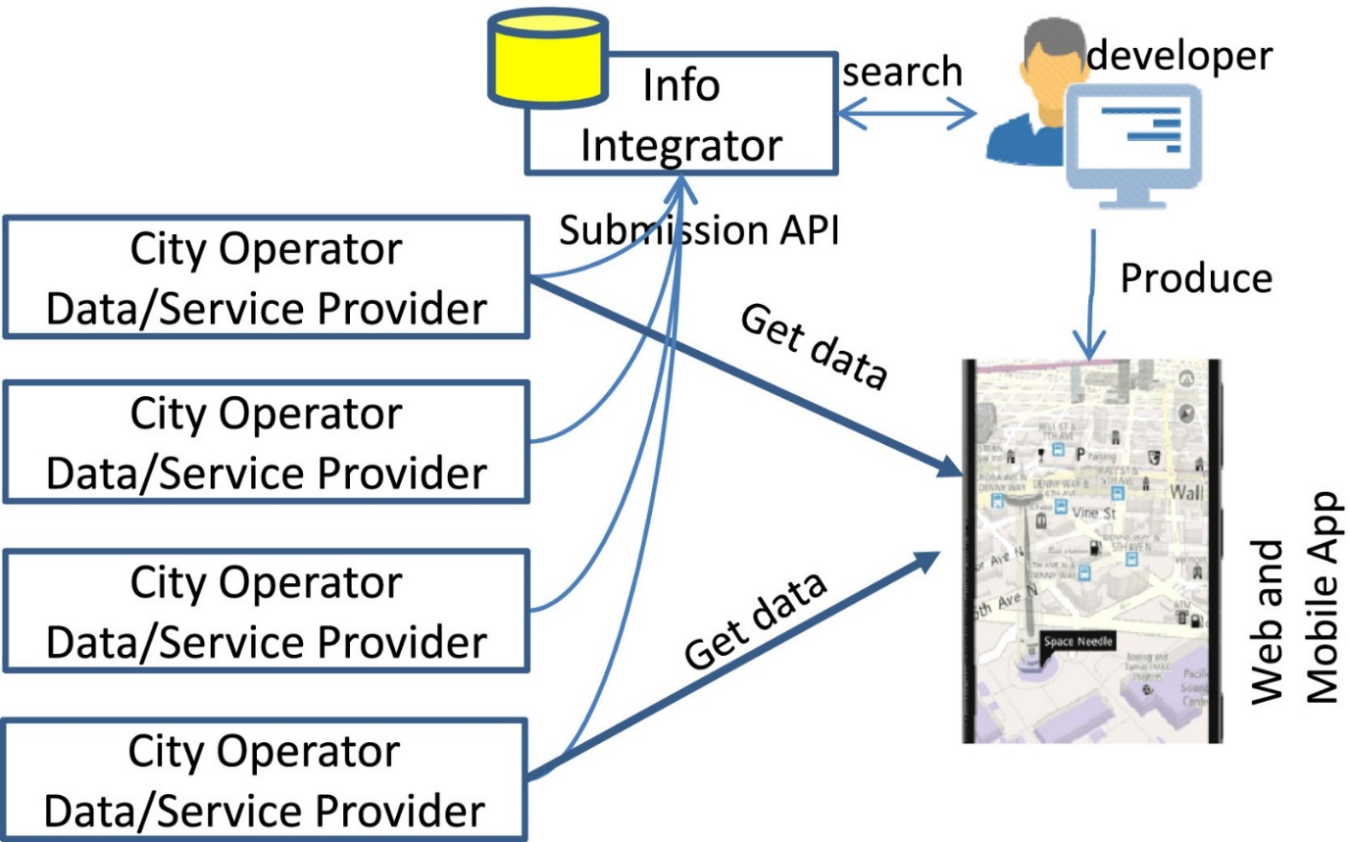
SYSTEM ARCHITECTURE

Slide 16
MODULES
Smart City Guide
Find destination location
Tourism And City Guide
Main information about smart cities

Slide 17
SMART CITY GUIDE
Smart city is defined by IBM as the use of information and communication technology to sense, analyse and integrate the key information of core systems in running cities. At the same time, smart city can make the information about main attraction of the city, hospital services, emergency contact numbers, famous restaurants of that city.

Slide 18
FIND DESTINATION LOCATION
This Project in Java provides info regarding the various aspects of city such as tourism, institutes, industry, geographical maps, ATM locations, etc. The implementation of this project solves most of the problems a new visitor faces while coming to a new city.

Slide 19
TOURISM AND CITY GUIDE
It provides the detailed information about the area, the famous places of those area, restaurant, hotels, shopping mall etc. and all the related details of these places. This provides the user very easy way to visit any place.

Slide 20
MAIN INFORMATION ABOUT SMART CITIES
This will definitely help the users for the purpose of saving their valuable time which can’t be got back which is also economically viable. This system provides a registration form for all who wants to get the services. This can be categorized based on the type of users. They can search for a prominent places in the city without taking any help from personal guide.

Slide 21
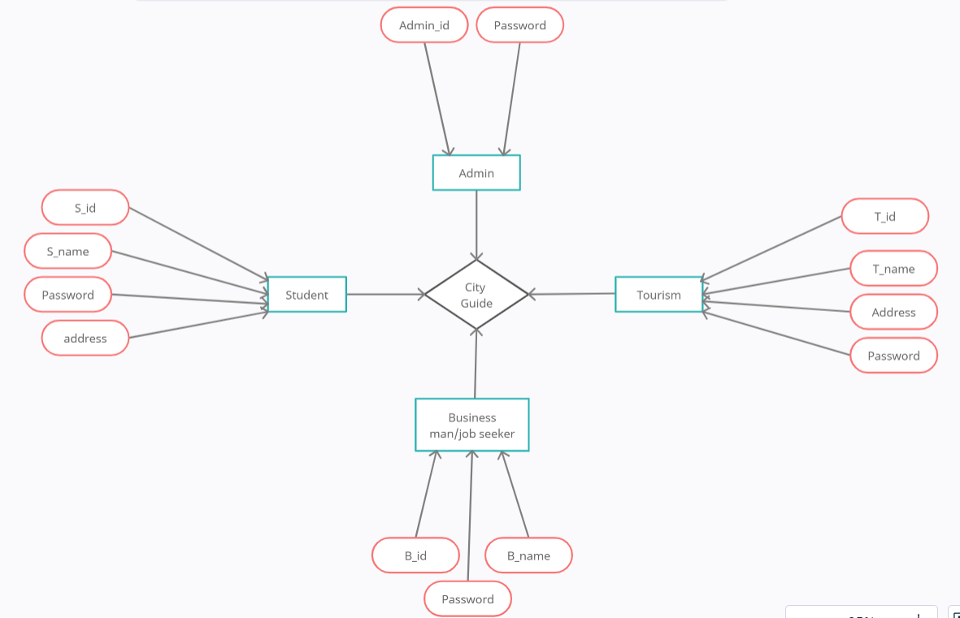
DATA FLOW DIAGRAM

Slide 22
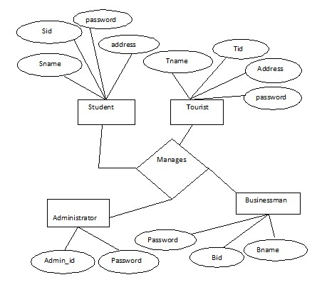
E-R DIAGRAM

Slide 23
USECASE DIAGRAM

Slide 24
CLASS DIAGRAM

Slide 25
Sequence Diagram of the User

Slide 26
Admin Site Update Sequence Diagram

Slide 27
Collaboration Diagram of the User

Slide 28
Administrator activity diagram

Slide 29
User Activity Diagram

Slide 30
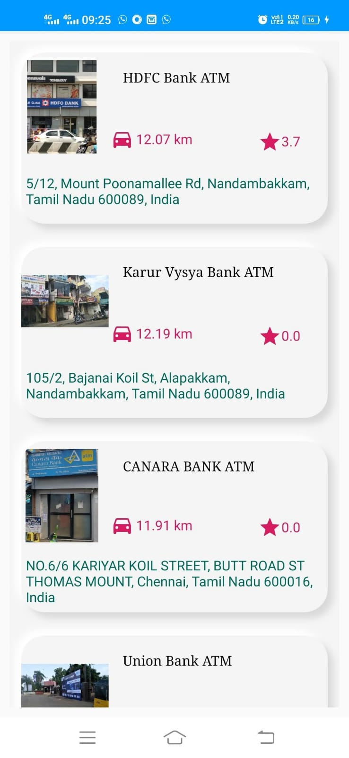
OUTPUTS

Slide 31
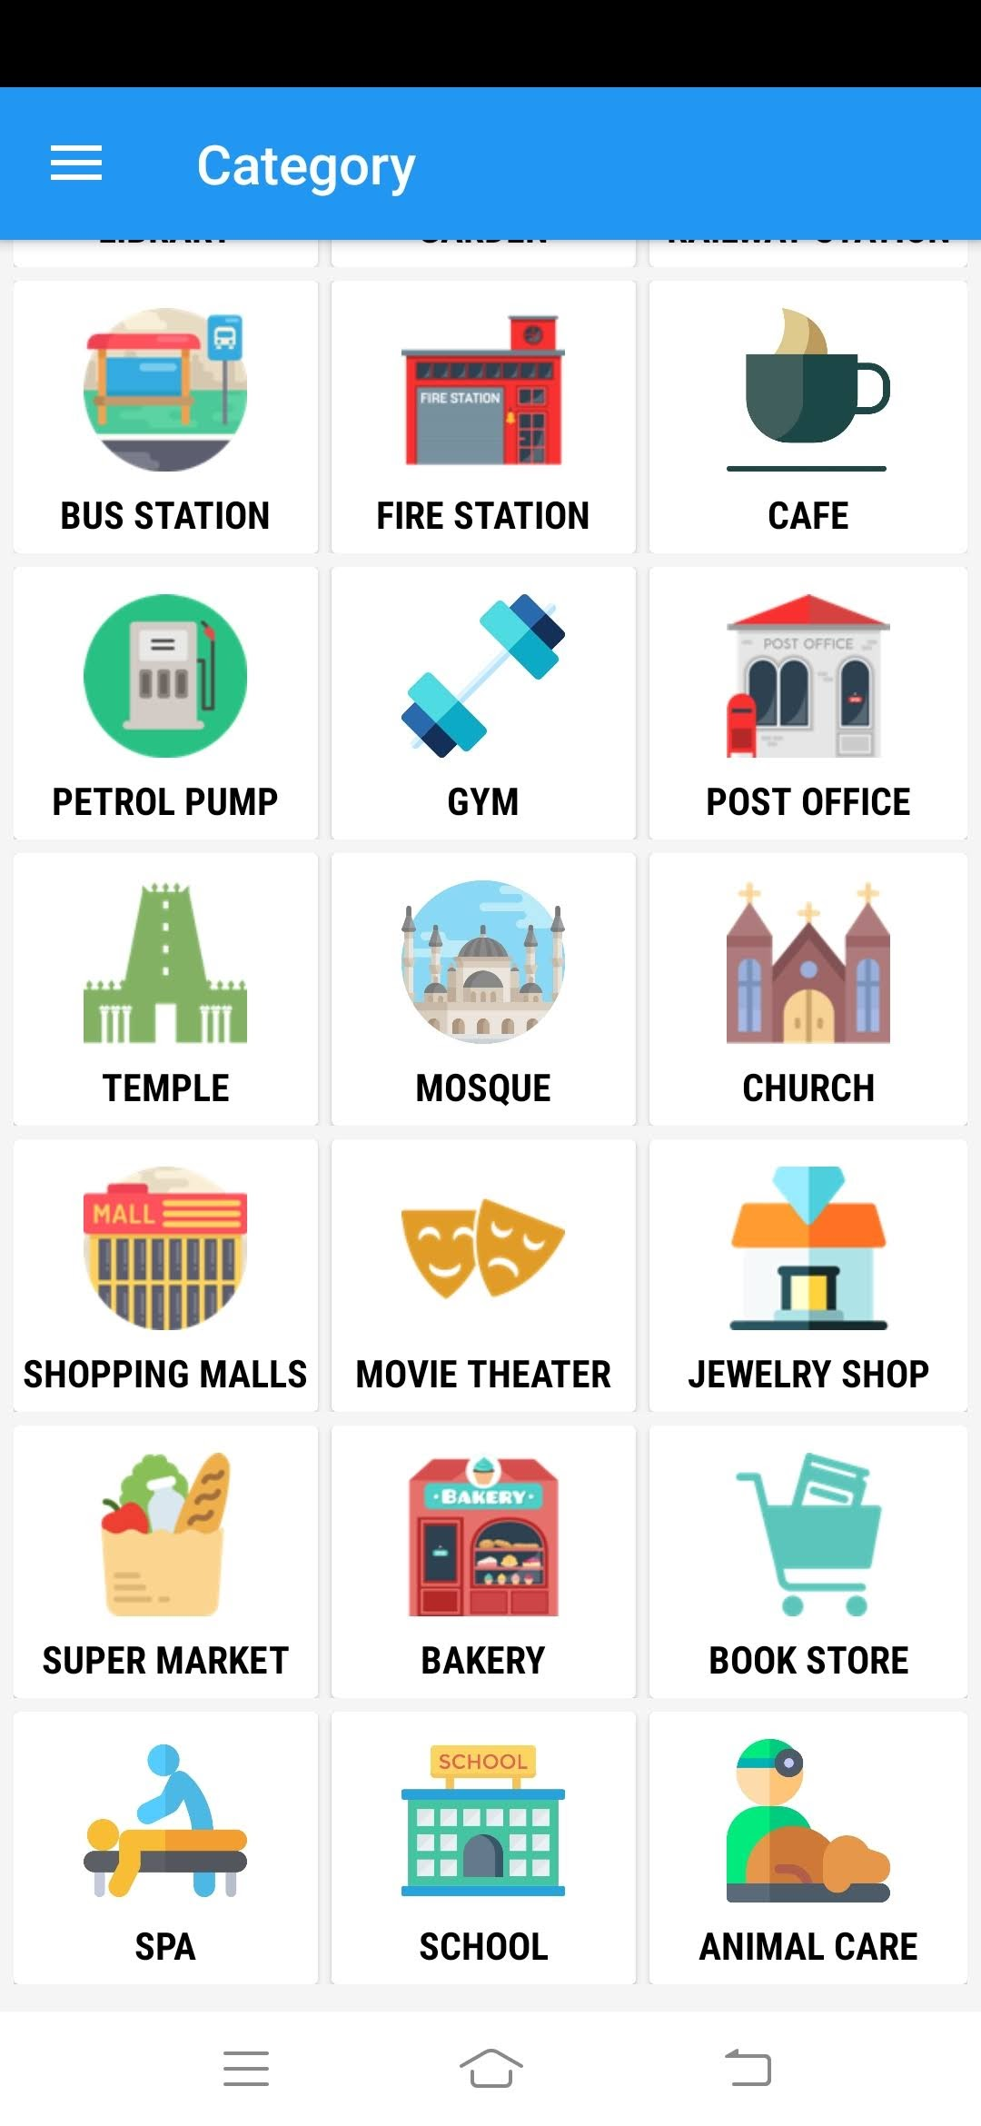
OUTPUTS

Slide 32
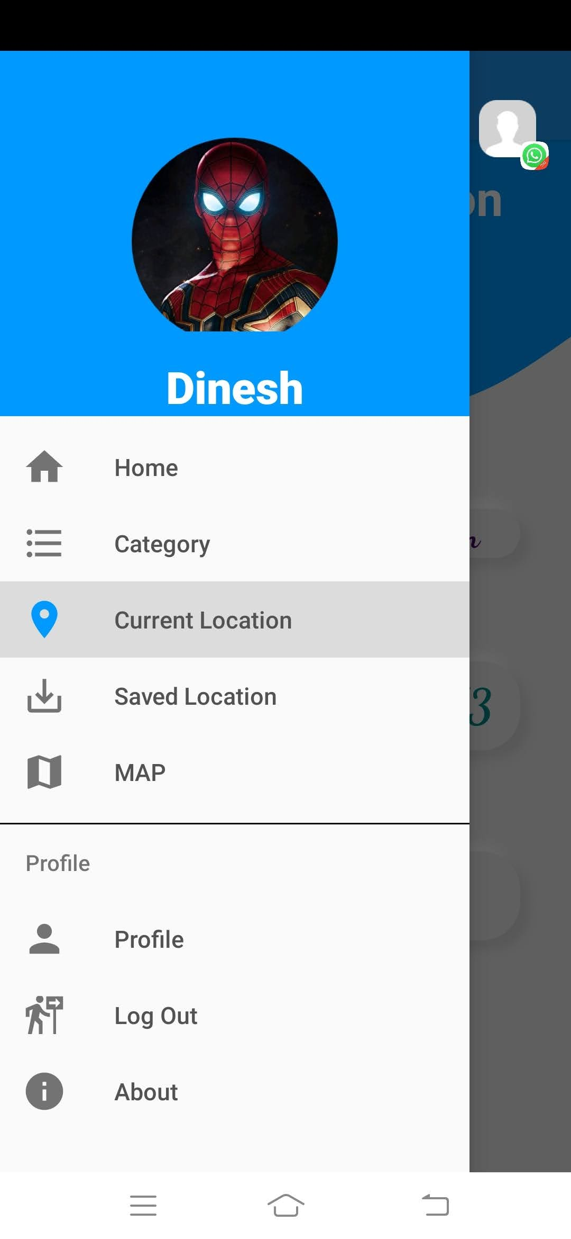
OUTPUTS

Slide 33
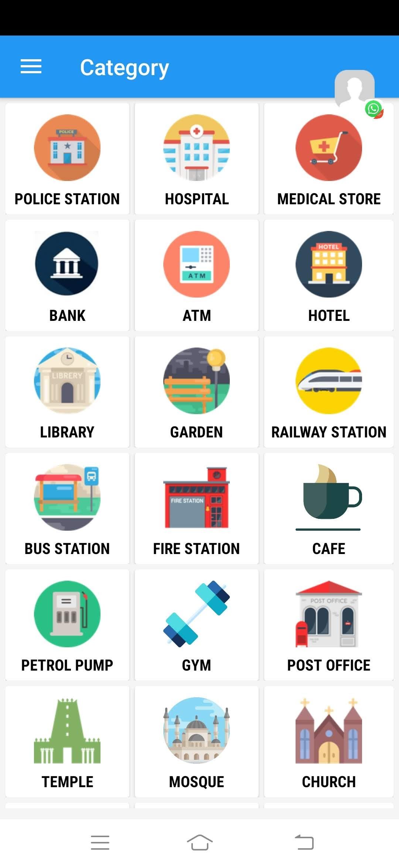
OUTPUTS

Slide 34
CONCLUSION
This Project in Java provides info regarding the various aspects of city such as tourism, institutes, industry, geographical maps, ATM locations, etc. The implementation of this project solves most of the problems a new visitor faces while coming to a new city such as: path finding, hotel searching, ticket booking, and more.

Slide 35
FUTURE ENHANCEMENT
As interesting directions of future work we identify the following two lines. First covering access range can be increased, rating system can also be embedded according to the user satisfaction. Apart from android it can also be made for Windows and IOS users. Navigation system can also be integrate for a particular place.

Slide 36
REFERENCES
1. Smart Cities, International Electrotechnical Commission. Available online: https://www.iec.ch/smartcities/ introduction.htm (accessed on 7 August 2020).
2. Gandy, O.H., Jr.; Nemorin, S. Toward a political economy of nudge: Smart city variations. Inf. Commun. Soc. 2019, 22, 2112–2126. [CrossRef]
3. Sadowski, J.; Pasquale, F.A. The spectrum of control: A social theory of the smart city. First Monday 2015, 20. [CrossRef]
4. Inclusive Smart Cities: A European Manifesto on Citizen Engagement. Available online: https://eu-smartcities.eu/sites/default/files/2017-09/EIP-SCC%20Manifesto%20on%20Citizen% 20Engagement%20%26%20Inclusive%20Smart%20Cities_0.pdf (accessed on 7 August 2020).
5. Ageing and Life-Course. Available online: https://www.who.int/ageing/projects/age-friendly-environments/ en (accessed on 7 August 2020.
6.Van Zoonen, L. Privacy concerns in smart cities. Gov. Inf. Q. 2016, 33, 472–480. [CrossRef]
7. Lai, C.S.; Lai, L.L.; Lai, Q.H. Smart Grids and Big Data Analytics for Smart Cities, 1st ed.; Springer International Publishing: New York, NY, USA, 2020.

Slide 37
REFERENCES
8. Camero, A.; Alba, E. Smart City and information technology: A review. Cities 2019, 93, 84–94.
9. Caird, S.P.; Hallett, S.H. Towards evaluation design for smart city development. J. Urban Des. 2019, 24, 188–209.
10. ISO/TR 37150:2014(en) Smart Community Infrastructures—Review of Existing Activities Relevant to Metrics. Available online: https://www.iso.org/obp/ui/#iso:std:iso:tr:37150:ed-1:v1:en (accessed on 7 August 2020).
11. ISO/TS 37151:2015 Smart Community Infrastructures—Principles and Requirements for Performance Metrics. Available online: https://www.iso.org/standard/61057.html (accessed on 7 August 2020).
12. Citykeys. Available online: http://citykeys-project.eu (accessed on 7 August 2020).
13. Hasija, S.; Shen, Z.-J.M.; Teo, C.-P. Smart city operations: Modeling challenges and opportunities. Manuf. Serv. Oper. Manag. 2020, 22, 203–213.
14. Anthopoulos, L. Smart City Emergence: Cases From Around the World; Elsevier: Amsterdam, The Netherlands, 2019.
15. van Winden, W.; van den Buuse, D. Smart city pilot projects: Exploring the dimensions and conditions of scaling up. J. Urban Technol. 2017, 24, 51–72. [CrossRef]

